Slide 1
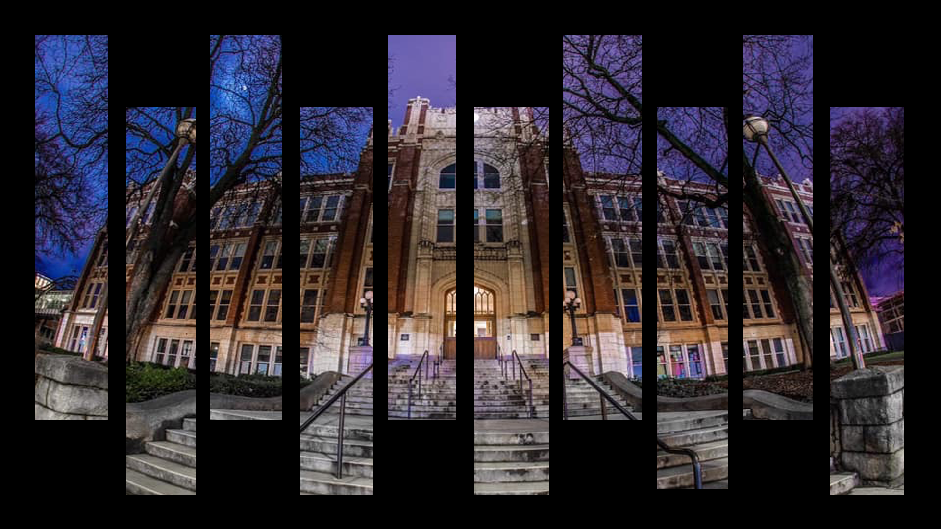
Welcome to
Lewis & Clark High School

Slide 2
LC Administrators
Principal - Ivan Corley
Assistant Principals
Student Services - Brandon Bouge, Phil High-Edward
Teaching & Learning - Janet Lane, Theresa Meyer
Principal Assistant - Rachel Glines
Activities/Athletics - Austin Johnson

Slide 3
Our Mission is to…
Create a safe and caring learning environment for all our students.
Provide an educational experience that exceeds high standards and provides graduates with the confidence, knowledge and skills to assure success in life.

Slide 4
The Elements of Success at LC
Providing the best instructional practices in every classroom
Sharing high expectations AND high support
Creating connections and fostering student involvement
Focusing on relationships and KNOWING kids
Being advocates for ALL students

Slide 5
LC’s Academic Achievements
Advanced Placement
24 different AP classes offered (over 55 sections)
1,151 AP tests given in 2023 with 69% earning college credit
179 AP Scholars in 2023
Named a Silver Award for AP Honor Roll 2023
Newsweek, WA Post, Daily Beast - LC is consistently listed as one of the state & nation’s best high schools.

Slide 6
Counselors & Student Support
9th Grade Counselors:
Amy Haghighi (A-J & SpEd)
Emily Magnuson (K-Z & ELD)
10th - 12th Grade Counselors:
Stacey Donahue (10th grade)
Charlene Dupper (11th grade)
Annette Pare (12th grade)
Student Support:
Calvin Bruce (College & Career)
Mayra Galvan (College Success Foundation)
Katrina Bech, Mike Nepean (Intervention)
Kari Hedges (Mental Health)
Sandra Mathews (Psychologist)
Curt Chambers (HEART Program)
Kaitlyn Painter (Campus Safety)
Gary Cooper (Campus Safety)

Slide 7
The Counselor Role
The counselor wears many hats:
Communication with parents, students, & teachers
Registration guidance
Post-High School guidance
Social-emotional support
Appointments with counselors are easy to make and, if necessary, students can be seen immediately for support.

Slide 8
It Takes a Little More to Be a Tiger!
Middle school performance has a significant effect on how well a student will do in high school.
High school is a new beginning - an opportunity to determine his/her own success!
Every class counts in high school - grades, attendance, and attitude matter!

Slide 9
Student Success
Consistent Attendance - your student needs to be here every day!
Monitor progress - grades and attendance can be tracked in real time on PowerSchool.
Communicate frequently - if you have a question or issue, email/call teachers as your first step as soon as an issue arises.
Stay current, remain persistent, and follow up for help.

Slide 10
Advisory
Once a week:
Same Advisor for all 4 years
Social emotional support
College and career readiness
School involvement and activities
Registration preparation and guidance
High School & Beyond Plan

Slide 11
Spring/Summer Opportunities
8th Grade Visit in June (TBD)
9th Grade Orientation in August
Find classrooms, reconnect with friends
NewTech Skills Center Summer Academy
Visit www.skillscenter.com for info on classes
Speed & Strength Camp
Get ready for Fall sports, meet coaches, make new friends
Summer Camps
Band, Football, Basketball, Softball, Soccer, & Volleyball

Slide 12
Making Connections
We offer 19 different athletic programs from 9th to Varsity
Over 44 different extracurricular activities and clubs
We know that students who are involved in high school:
perform better in academic classes
feel a greater sense of confidence and self-esteem
have a higher attendance and graduation rate
are less likely to get involved in drugs/alcohol

Slide 13
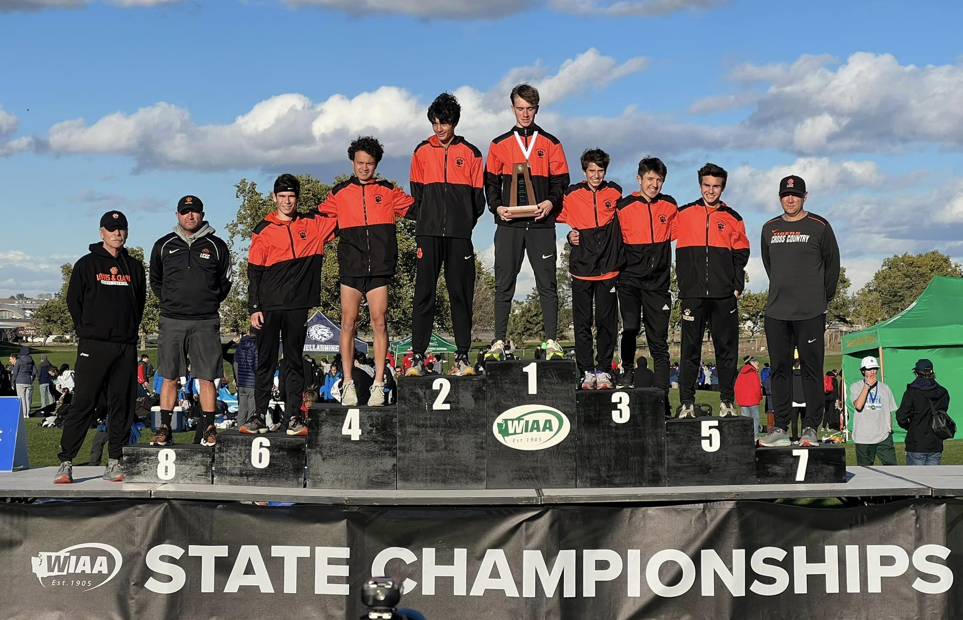
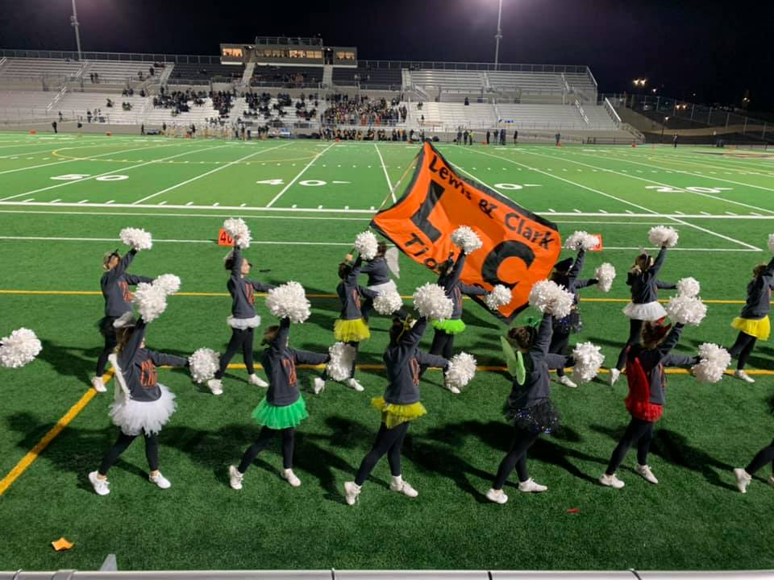
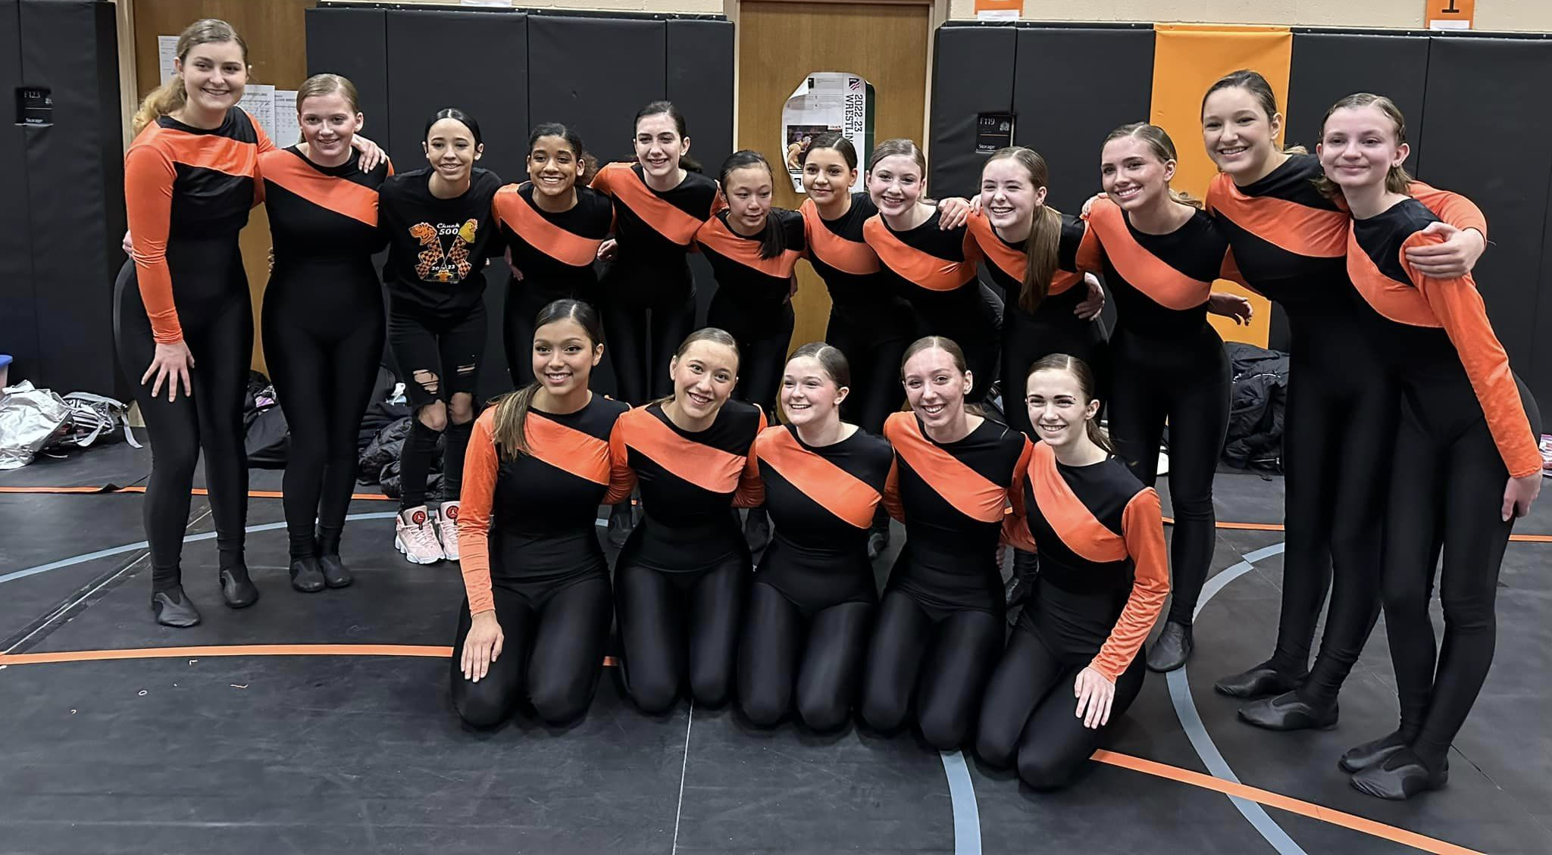
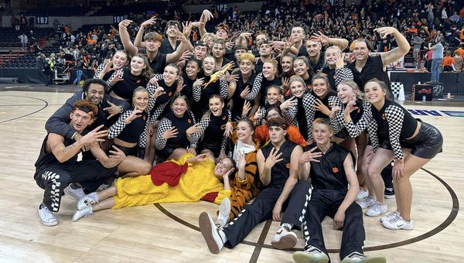
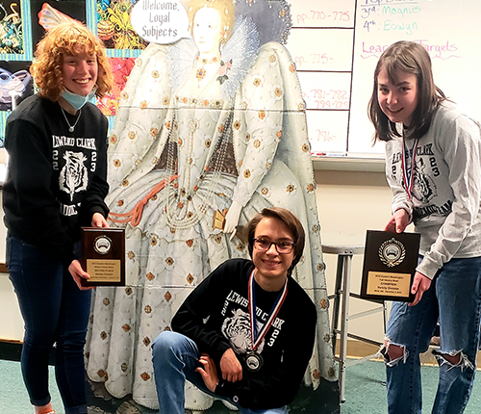
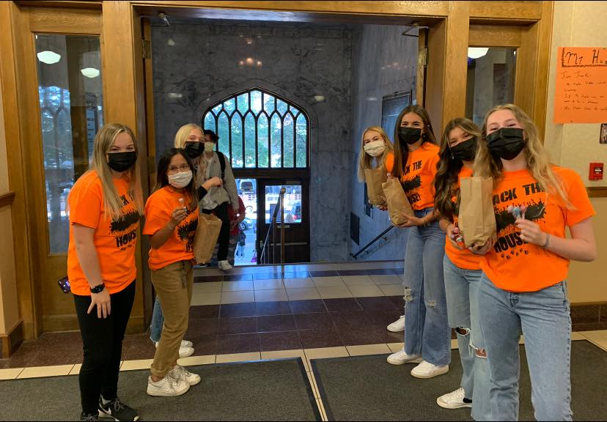
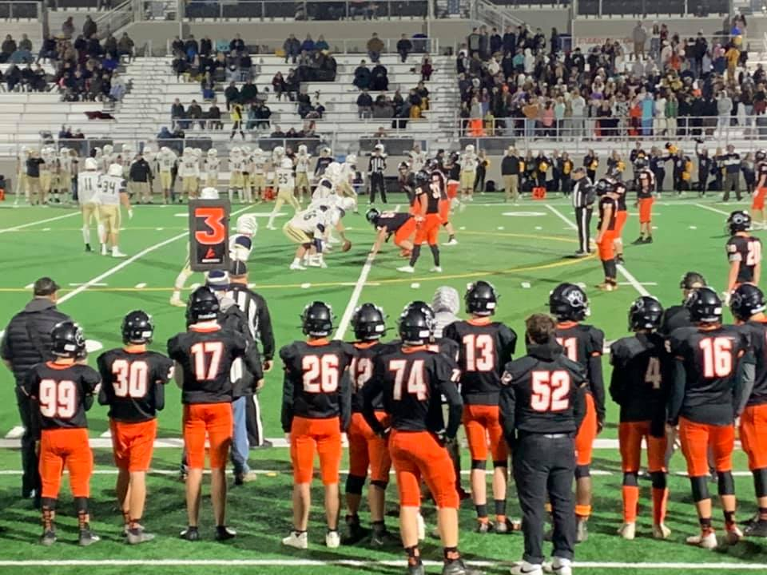
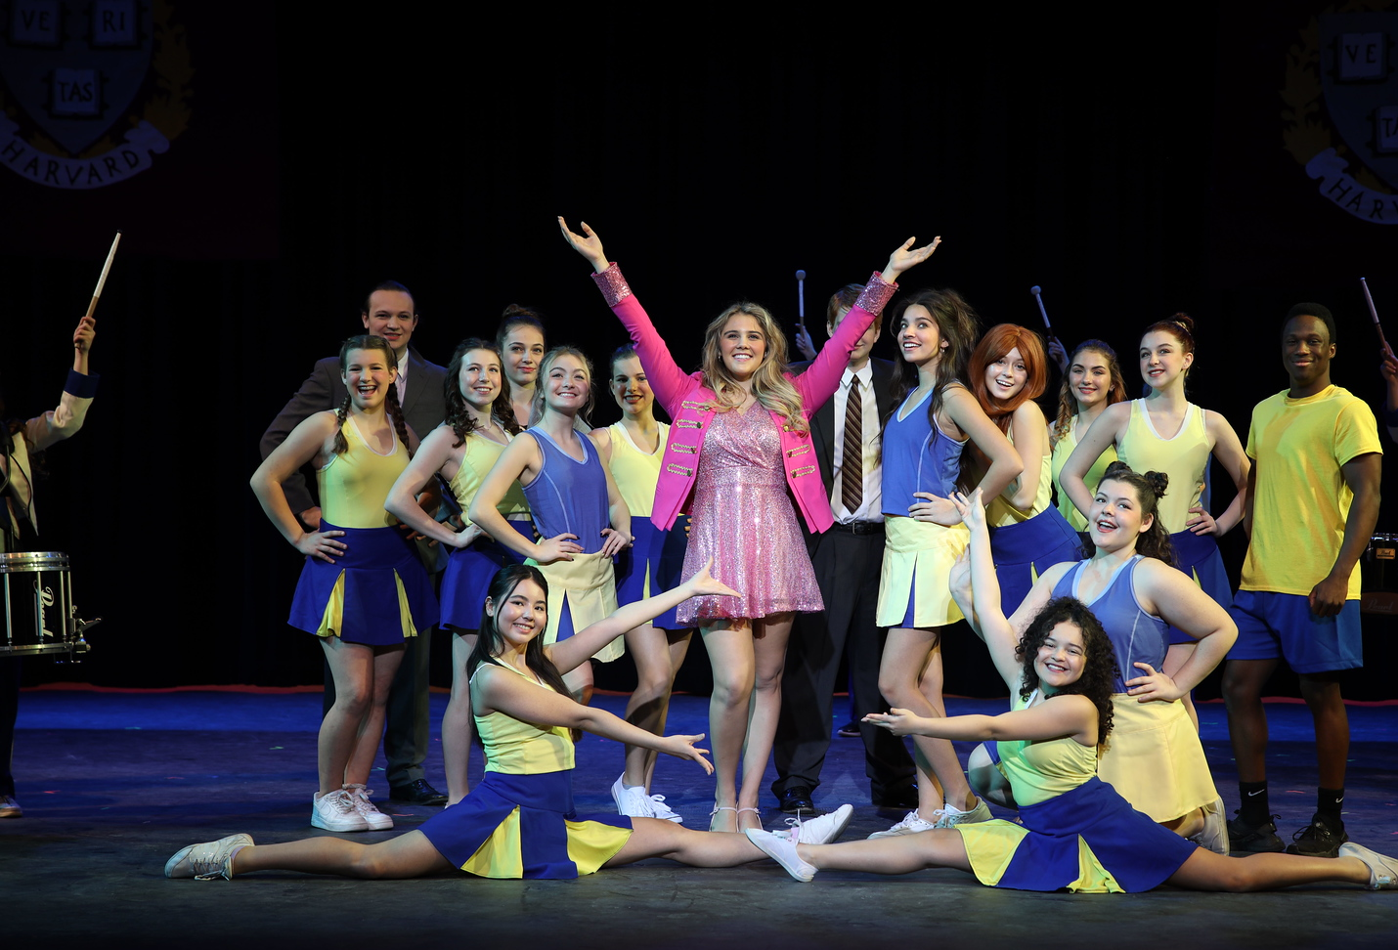
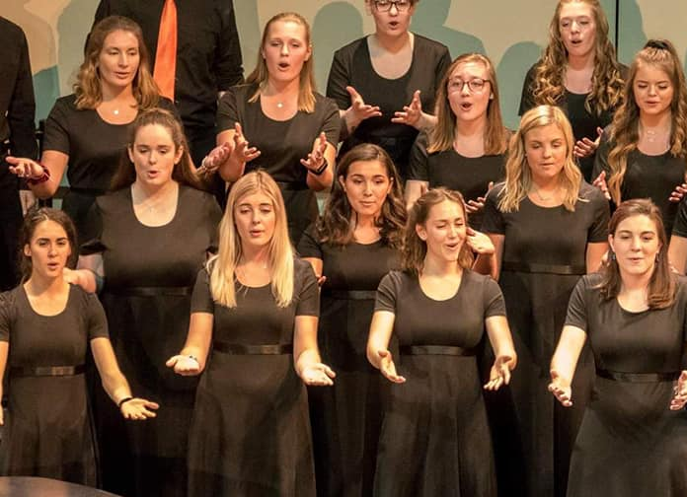
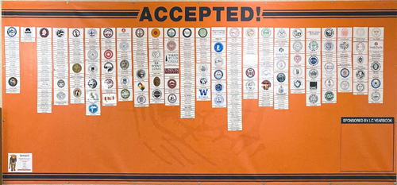

Slide 14
Examples of Activities & Athletics
Athletics | Track & Field | Baseball | Tennis
Football | Cross Country | Soccer | Fast Pitch Softball
Volleyball | Slow Pitch Softball | Drill Team | Golf
Wrestling | Basketball | Gymnastics
Activities | 9th Leadership | Debate Team | Knitting Club
French Club | Spanish Club | Video Club | Games Club
Japanese Club | Drama Club | CyberPatriots | Spectrum
Key Club | Sports Med Club | Chess Club | Environmental Club
Nat’l Honor Society | DECA | Knowledge Bowl | Future Health Pros

Slide 15
Parent Connections
Boosters: Athletic/Activity supporters
LCMPA: Band/Orchestra/Choir parent group
STAGE: Drama parent group
Parent Advisory Group
Visit www.lctigers.com for school info
Follow us on Facebook
Join the “LC News You Can Use” email group
Make sure you are PowerSchool savvy!

Slide 16
Choice Transfer Requests
All transfer requests are handled at the district level using an online portal
If you haven’t yet applied, there is still time, but do not wait too long - the deadline is February 15 for round 1
Within a week of the portal closing, we’ll begin making acceptance contacts!

Slide 17
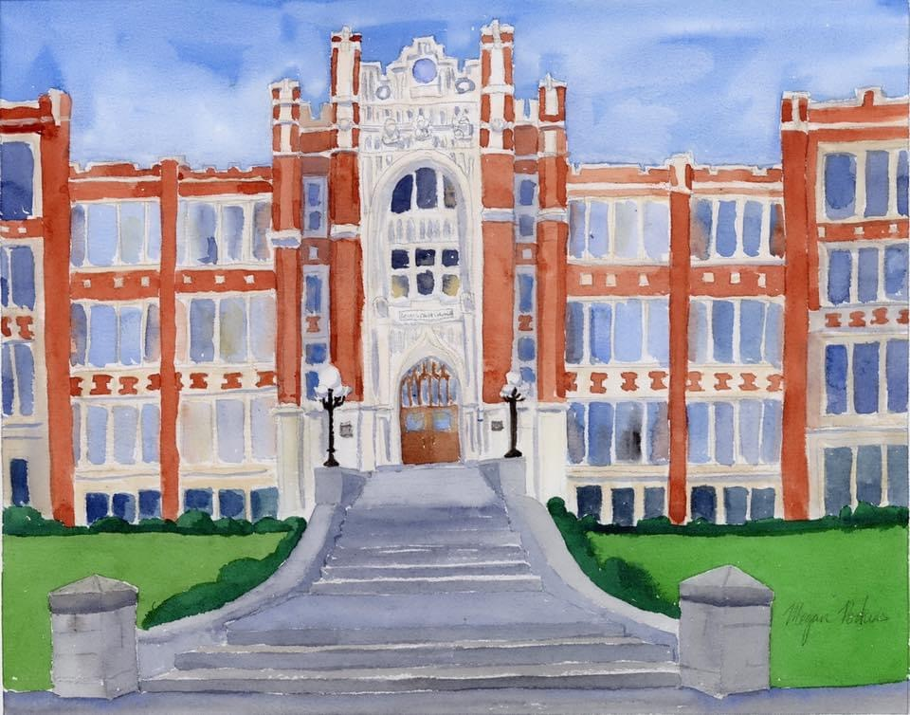
LC 9th Grade Course Offerings

Slide 18
Graduation Requirements
Category | 24.0 Required | 24.0+ Recommended
English | 4.0 | 4.0
Social Studies | 3.0 | 3.0
Mathematics | 3.0 | 4.0
Science | 3.0 | 4.0
CTE | 1.0 | 1.0
Health | .5 | .5
Fitness | 1.5 | 1.5
Arts | 1.0 | 1.0
Electives | 7.0 | 5.0
Total | 24.0 | 24.0

Slide 19
ENGLISH OPTIONS 4 credits required to graduate
ENGLISH 9 Focus on reading, writing, grammar using the Springboard Curriculum
ENGLISH 9 Honors More sophisticated reading and writing instruction to prepare for AP at 11th/12th grades

Slide 20
MATH OPTIONS 3 credits required, 4 recommended
Algebra
Geometry
Algebra 2
The next step after 8th grade math. If you are earning a C, D, or F in Algebra now, you might want to take Algebra again.
Honors
Geometry
Honors
Algebra 2
After Algebra in 8th grade if you are earning a B or better.
After Geometry in 8th grade if you are earning a B or better.

Slide 21
SCIENCE OPTIONS 3 credits required, 4 recommended
BIOLOGY
Full year of biological plant and animal sciences as a foundation for higher-level science.
MESA BIOLOGY
Same as Biology, but only for girls & students of color. Work with WSU & EWU on special projects.
HONORS CHEMISTRY
Strongly suggested that you have taken Algebra in middle school with a B or better. Recommended for general interest in science or a focus on biological sciences.
HONORS PHYSICS
Rigorous advanced option, research project class. Strongly suggested that you have taken Algebra in middle school with a B or better. Recommended for a specific interest in math or engineering.

Slide 22
HEALTH/FITNESS .5 health required; 1.5 fitness required
HEALTH
1 semester class on physical and mental health
FITNESS/ADVANCED CONDITIONING/ADVANCED LIFETIME FITNESS
1 semester class focusing on creating lifetime fitness habits
SVL
Online options for health and fitness. If you take these classes in SVL, you will open an additional elective period in your schedule. You MUST register for SVL online, this process doesn’t register you for SVL.

Slide 23
CTE ELECTIVES
C T E | Business: Accounting Business and Marketing Sports Entertainment Marketing Health & Human Services: Child Development Criminal Justice Foods & Nutrition Legal Studies Principles of Biomed Sci PLTW Yr 1 Sports Medicine
C T E | Engineering & Technology: AP Computer Science AP Computer Science Principles Computer Science Essentials PLTW Cyber Security PLTW Digital Game Programming Intro to Engineering Design PLTW àCivil Engineering & Architecture PLTW àPrinciples of Engineering Design PLTW TV/Video Production Web Design Yearbook - teacher permission required

Slide 24
ART & GENERAL ELECTIVES
G E N E R A L | AP Human Geography Career Choices Chinese Year 1 àChinese Year 2 àChinese Year 3 Honors French Year 1 àFrench Year 2 Japanese Year 1 Spanish Year 1 àSpanish Year 2 àSpanish Year 3 Honors
AR T S | Band Choir Orchestra Percussion Ensemble (Drums) Drawing, Sculpting, & Painting Theatre - Beginning àTheatre - Intermediate Web Design
Zero Hour | Debate Jazz Band [Art] Jazz Choir [Art]

Slide 25
Middle School Registration
February 7 - Odyssey Middle School (20)
February 8 - Yasuhara Middle School (3)
February 9 - Spokane Public Montessori (10)
February 13 - Sacajawea Middle School (364)
February 14 - Flett Middle School (1)
February 16 - Chase Middle School (9)
February 21 - Garry Middle School (1)
February 22 - Shaw Middle School (3)
TBD - Peperzak (5) & SVA (2)

Slide 26
Breakout Rooms
If you have questions about specific classes/departments/course sequences/etc. go to the room listed on the white sheet.
Teachers will be available in the rooms to answer all of your questions.
All rooms are located on the main floor.

Slide 27
Breakout Rooms
Room 135 | Room 133 | Room 129 | Room 127 | Room 125
Science | Special Education | Fine Arts | World Language | English
Room 123 | Room 121 | Room 119 | Room 115 | Room 107
Social Studies | Math | ELD | CTE | Fitness
Front Hall |  | The PowerPoint from this evening’s presentation and other registration resources can be found at: bit.ly/LCHSReg If you have questions, please contact Theresa Meyer (theresam@spokaneschools.org) or Janet Lane (janetl@spokaneschools.org)
Counselors, Administrators, & Clubs/Activity Information tables Feel free to walk around the building.

Slide 28
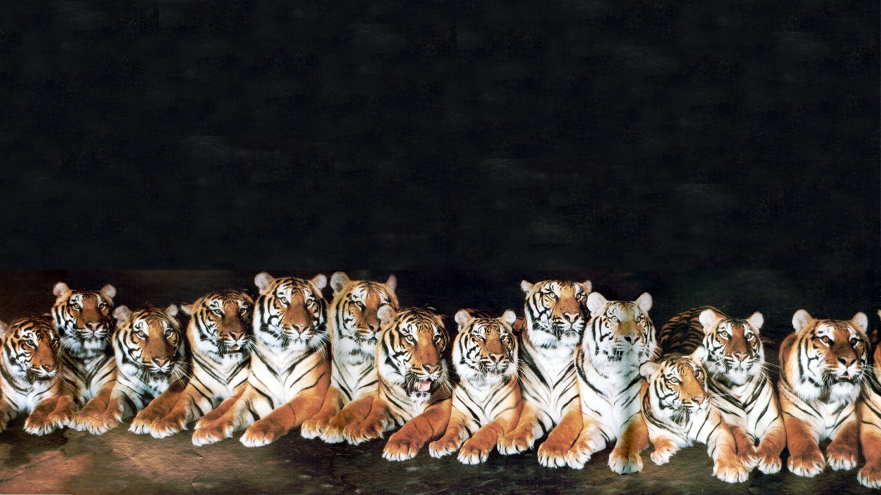
We are excited to welcome the Class of 2028 into our Tiger Family!

